Slide 1
Social Determinants of Health
A curriculum for Changemakers
on
History & power, ANti-racism, challenGing oppression, and promoting Equity

Slide 2
Agreements
Speak your truth without blame or judgement:
No one speaks for the entire group.
Be open about thoughts and feelings and not just saying what you think others want to hear.
Normalize that you will have emotional responses to some of the topics.
Encourage taking responsibility for only yourself, notice a tendency to blame or judge, and let this go to stay engaged.
Listen fully, with our ears, eyes and heart to learn from one another:
No one comes to these conversations as experts.
We are all learning about one another and the differences we bring to the conversation.
Assume that we are all learning together.
If on zoom, use your camera for any discussion time
Mute your microphone when you are not speaking
Limit chat box to operational concerns or to indicate a desire to speak. No side conversations
Notice the amount of space you are taking up in the room. Create space for others to speak
Notice moments of discomfort and stay curious and engaged:
“Remain morally, emotionally, intellectually, and socially involved in the dialogue
Acknowledges that discomfort is inevitable
Make a commitment to bring issues into the open
Acknowledge that ivisiveness already exists in society. It is through dialogue, even when uncomfortable, that healing and change begin.
Be open to the experience and expect and accept non-closure:
Be open to hearing experiences different than your own
Be willing to ”hang out in uncertainty”
Do not rush to quick solutions
End the session on time, even though we will never be “done”
What’s said here stays; what’s learned should leave:
Maintain confidentiality outside of the dialogue.
Do not rehash conversations or share personal stories of others outside of the agreement space.
Absolutely share the learning that happened-- just taking the individual out of it
No recording of sessions

Slide 3
Notes:
U.S Department of Health and Human Services. (May 16th, 2022). 5 Social Determinants of Health in Healthy People 2030. YouTube. https://www.youtube.com/watch?v=2UK7NrHOsmA&t=152s

Slide 4
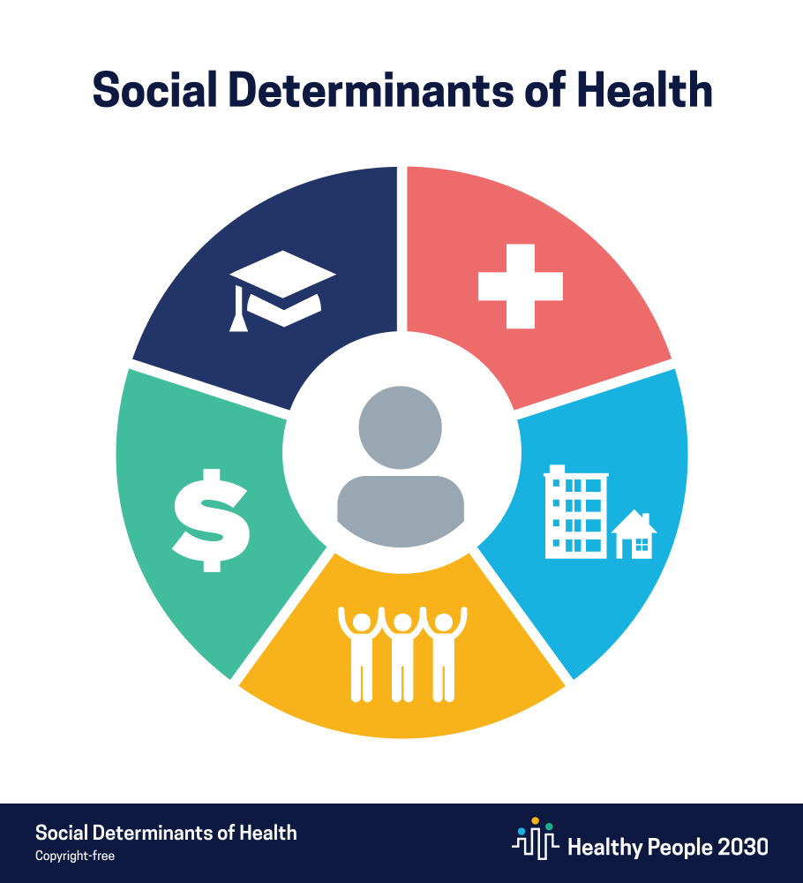
Economic Stability
Education
Health and Healthcare
Neighborhood and Built Environment
Social & Community Context
Notes:
Healthy People 2030 from the CDC identifies five core areas of the SDoH. There are other frameworks with slight variations, but for sake of ease, we will use the CDC framework because it will allow us to do some small group work together
Economic Stability
Education
Social & Community Context
Neighborhood and Built Environment
Health and Healthcare

Slide 5
Systems of oppression such as: racism, sexism, ableism, homophobia, size-ism, transphobia, weight bias, xenophobia, religious bias, etc.
Systems of power such as: socioeconomic and political landscape; who is making the decisions and why
Systems of Power and Oppression
Social Determinants of Health
Individual factors and behaviors
Structural Determinants of Health
Social Determinants
of Equity
Notes:
Side note: some models include a third layer, called “social determinants of equity” or “structural determinants of health”. These terms generally refer to systems of power and oppression that shape the socioeconomic and political context, that in turn impact the social determinants of health.
We will spend the bulk of this curriculum exploring these so-called determinants of equity. However, it requires more context! Much of medical training is focused on individual behaviors, when largely social determinants of health and social determinants of equity shape health outcomes

Slide 6
Small Group Activity-- Instructions
Describe HOW, WHY and TO WHAT EXTENT your group’s assigned core SDoH impacts health.
Economic Stability
Education
Social & Community Context
Neighborhood and Built Environment
Health and Healthcare
Notes:
We will be breaking into small groups:
Each group will be assigned to consider one of the five core SDoH.
After time for independent work, groups will reconvene and present to each other on what they have discovered.

Slide 7
Notes:
The next few slides are some examples of things using “health care” as an SDoH that you might bring back to the group. Please notice these are very rough, cut and paste pictures, that sort of thing– not requiring any amazing slide artistry! Your group may make slides if you wish, or just take notes to share verbally. You are NOT expected to have the amount of information in this example; this is just meant to provide a broad array of things you might find and report back.
Above info from the Robert Wood Johnson Foundation. Acording to research done at the Robert Wood Johnson foundation, clinical care only accounts for about a 20% role in impacting health outcomes, with a 30% role played by patient behaviors, and the remaining 50% accounted for by upstream influences of social & economic factors (40%) and the physical environment (10%)

Slide 8
Notes:
If patients are unable to engage in the healthcare system, they never even have a chance to be part of the diagnostic process. This is an image from the National Academies of Science report on diagnostic error. The report focuses primarily on the “circle” part of this diagram and rightwards.

Slide 9
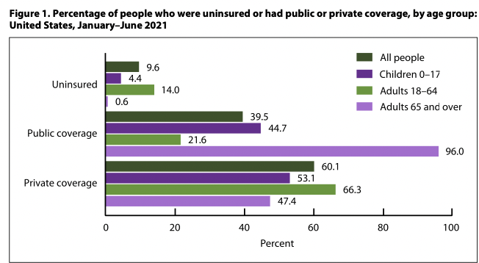
Systems of healthcare coverage:
-From January through June2021 ,among people of all ages, 9.6%were uninsured, 39.5% had public coverage, and 60.1% had private coverage at the time of interview.
-Adults aged 18–64 were the most likely to be uninsured(14.0%), followed by children aged 0–17 years (4.4%) and adults aged 65 and over (0.6%).
Notes:
Source: Robin A. Cohen, Ph.D., Michael E. Martinez, M.P.H., M.H.S.A., Amy E. Cha, Ph.D., M.P.H., and Emily P. Terlizzi, M.P.H. (2021, November). Health Insurance Coverage: Early Release of Estimates From the National Health Interview Survey, January–June 2021. https://www.cdc.gov/nchs/data/nhis/earlyrelease/insur202111.pdf

Slide 10
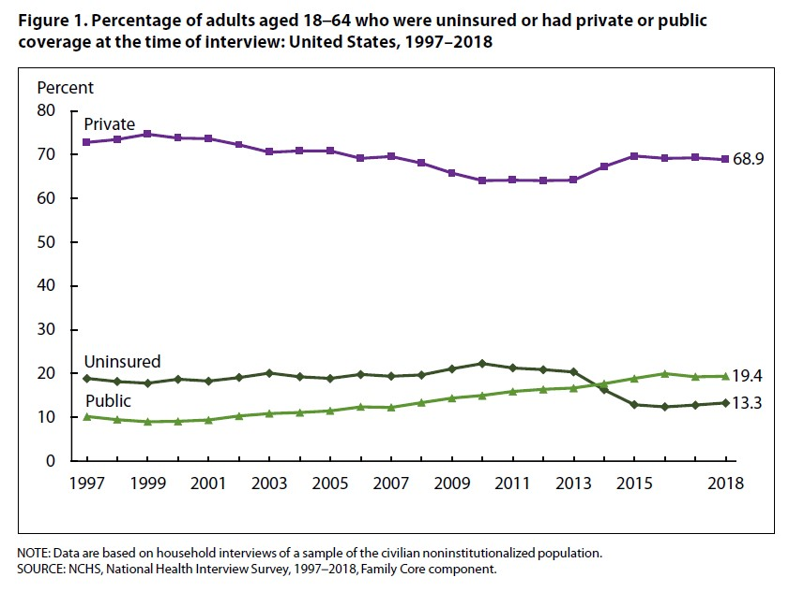
Notes:
Source:Health Insurance Coverage: Early Release of Estimates From the National Health Interview Survey, 2018, tables I, II pdf icon[PDF – 648 KB]

Slide 11
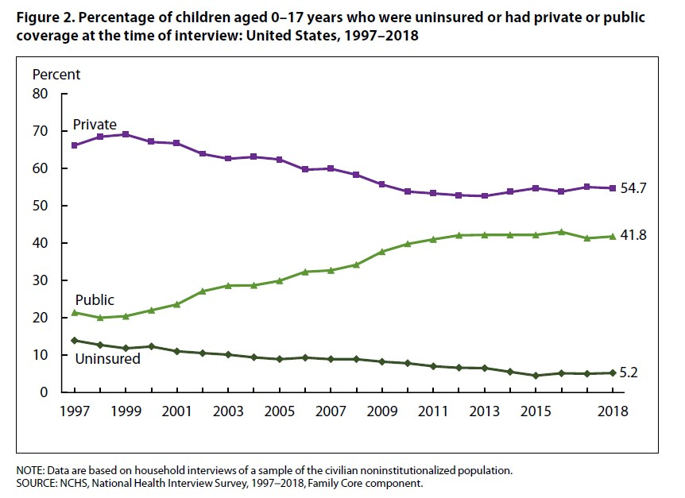
Notes:
Source:Health Insurance Coverage: Early Release of Estimates From the National Health Interview Survey, 2018, tables I, II pdf icon[PDF – 648 KB]

Slide 12
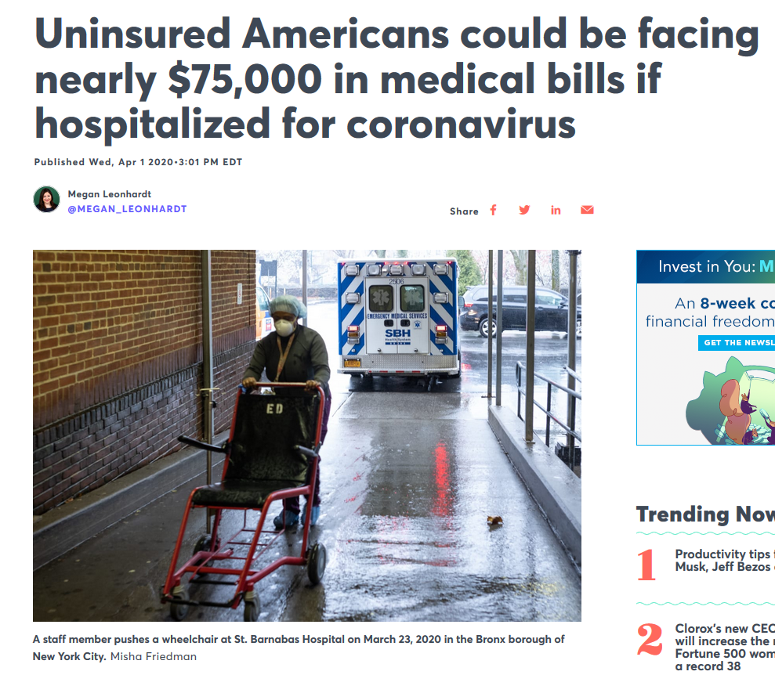
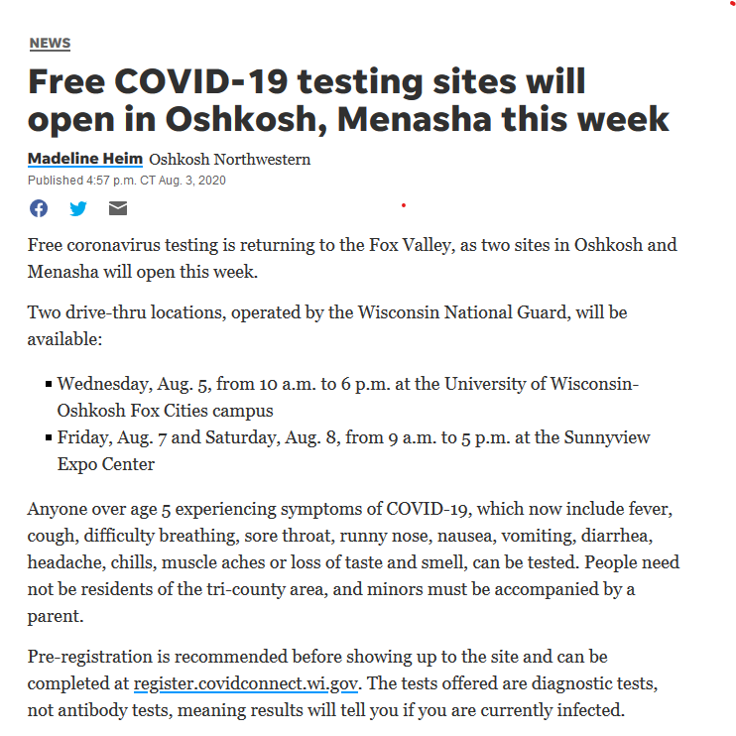
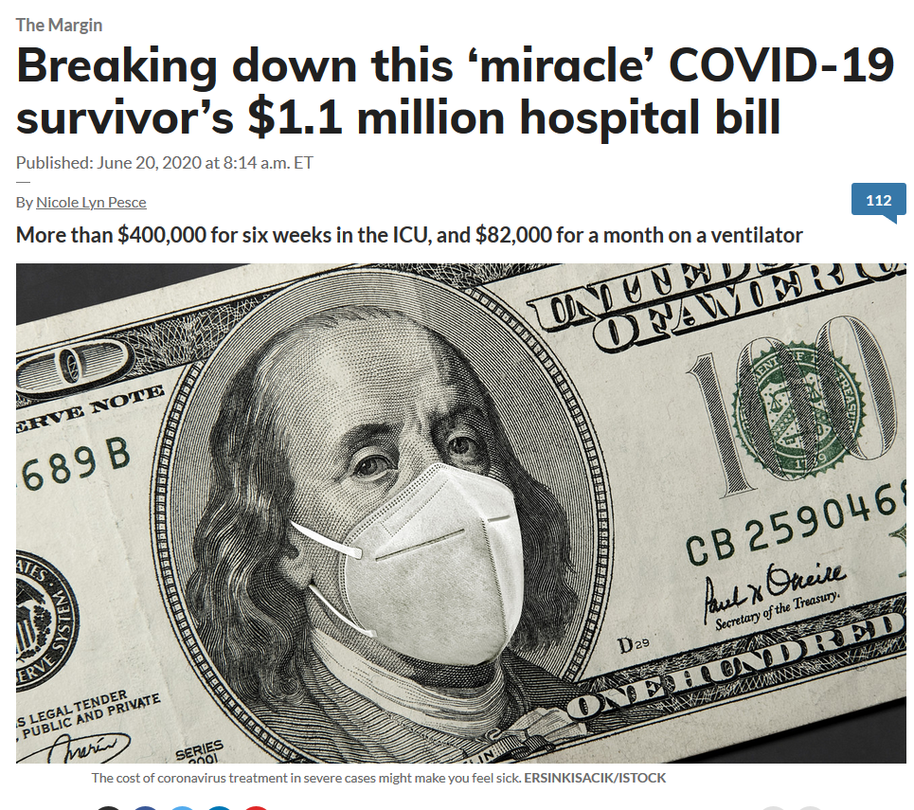
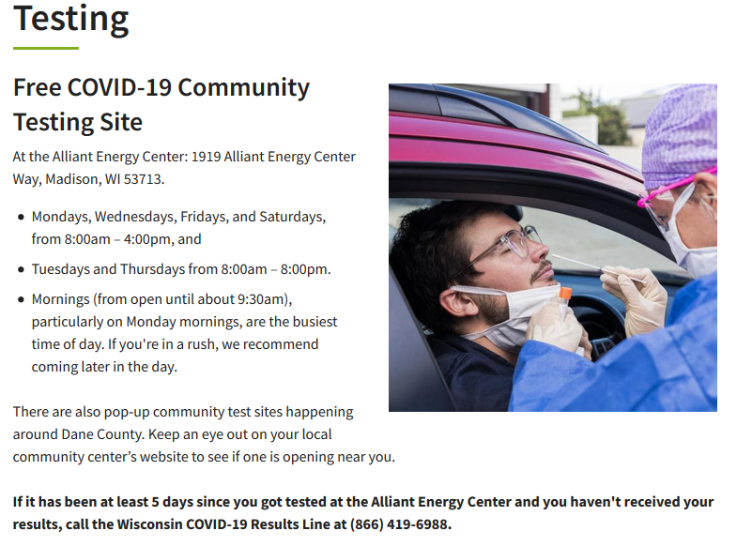
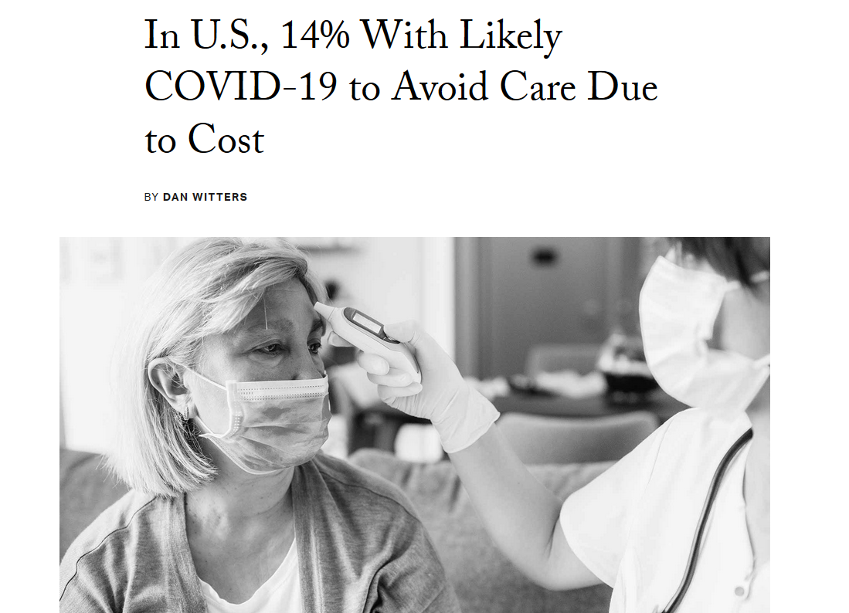
Notes:
Example of COVID and entry into the healthcare system
--where is testing available
--what are costs of care and tests
--who has access
Relationship of rationing to care to age, weight, co-morbidities→ why some communities are disproportionately impacted

Slide 13
Health Literacy
Complex relationship with overall literacy
Impacted by preferred language and ability status
Provider driven challenges:
Jargon
Smart phrases or other ‘blown in’ text
Time! (take two tablets by mouth twice daily… ~35% could demonstrate this)
Health Literacy (WHO) “The cognitive and social skills which determine the motivation and ability of individuals to gain access to, understand and use information in ways that promote and maintain good health.”
Notes:
Literacy– including level of education and ability status (eg dyslexia, visual impairment, etc)
Language– lack of appropriate materials; appointment lengths unchanged whether or not using an interpreter
Study: among individuals with low health literacy, only 35% could demonstrate what was meant by the phrasing “take 2 tablets by mouth twice daily”)

Slide 14
Small Group Activity-- Instructions
Describe HOW, WHY and TO WHAT EXTENT your group’s assigned core SDoH impacts health.
Economic Stability
Education
Social & Community Context
Neighborhood and Built Environment
Health and Healthcare
Notes:
We will be breaking into small groups:
Each group will be assigned to consider one of the five core SDoH.
After time for independent work, groups will reconvene and present to each other on what they have discovered.

Slide 15
Consider what you have learned in the video, as well as using external resources, to describe HOW, WHY and TO WHAT EXTENT your group’s assigned core SDoH impacts health.
https://www.healthypeople.gov/2020/topics-objectives/topic/social-determinants-of-health
https://www.healthypeople.gov/2020/topics-objectives/topic/social-determinants-health/interventions-resources
https://edhub.ama-assn.org/steps-forward/module/2702762
https://nam.edu/social-determinants-of-health-101-for-health-care-five-plus-five/
https://www.rwjf.org/en/our-focus-areas/topics/social-determinants-of-health.html
https://www.cdc.gov/nchhstp/socialdeterminants/faq.html
https://www.dhs.wisconsin.gov/resilient/social-determinants.htm

